Slide 1
RGB COLOR SENSOR PROJECT Team Sagittarius
Final Evaluation - 10th August

Slide 2
Project targets
Identifying the color of an object
Display the RGB values
Output the corresponding color in RGB LED
( Sending to remote device - via Bluetooth )
Lighting the RGB LED for a user input color
Input from keypad
(Remote user input - via Bluetooth)
Using only 1-PWM pin for RGB LED

Slide 3
Division of Main Tasks
Task | Index | Name
Sensor and Calibration | 190301H | Karunanayaka Y.S.
User Interface and Display | 190286M | Kajhanan. K.
User Inputs / Keypad | 190280N | Jegakumaran P.
Output RGB LED | 190285J | Kahawalage A.P.P.

Slide 4
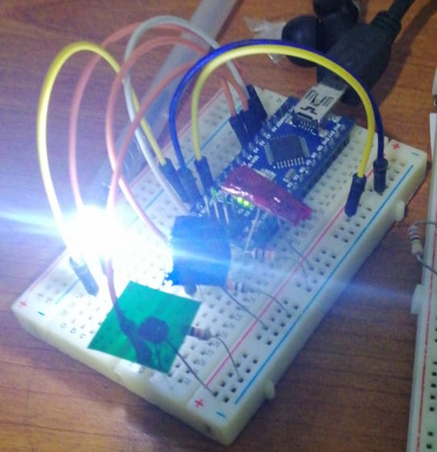
Basic idea of sensor
Using : One white LED + 3 LDRs with RBG filters papers
Each color filter lets pass only one main color (R,G or B).
Therefore, using each LDRs resistance values at a given time we can measure the amount of each color reflected from the object.
White LED
After experimenting with several calibration procedures, we could detect both primary colors and secondary colors accurately.
LDR with
Red filter
LDR with
Green filter
LDR with
Blue filter

Slide 5
Calibration
CALIBRATION 01 - System calibration (done only once)
To overcome the differences in each sensor for RED, GREEN, BLUE and keep them in a common ground.
Done using 9 shades of WHITE , (GREY) to BLACK
CALIBRATION 02 - Calibration considering user expectations
To map the RGB values user expect and what sensor really recognized
Done using any color given by user and its expected color composition

Slide 6
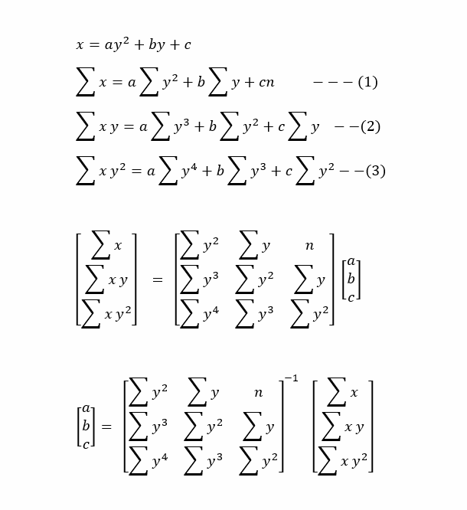
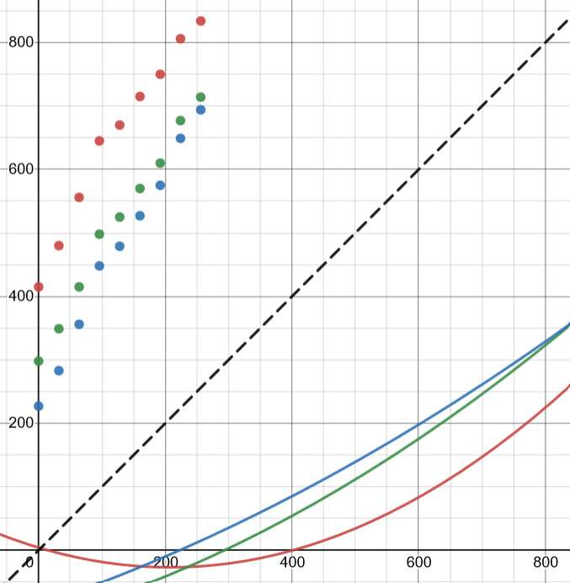
Calibration process explained
Samples of nine shades of grey
Mirror
Line → Real color intensity
Points → Measured color intensity
Calculated
curves
Points → Real color intensity
Line → Measured color intensity

Slide 7
Methods of calibration
Grey scale calibration
Calibration done using 9 shades of grey.
A more reliable calibration method because,
It covers entire 0 – 255 range all 3 fundamental colors
Calibration material can be accurately printed using any printer
This is the recommended method for the device
Color code calibration
Calibration done by 1-9 codes of colors
The exact color of the material should be known
The calibration calculates the approximation for the most fitting curve.
Not reliable. Because,
The color code always has an error.
Same color may change the reflection due to the material.
Printers cannot accurately print these colors.

Slide 8
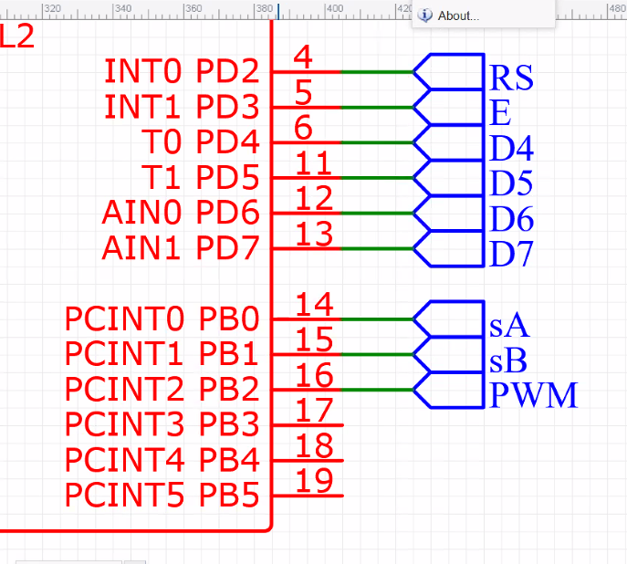
User inputs - Keypad
Since still we can not use 7 dedicated pins for the keyboard, we selected 4 pins which are already used for display to send signals. And another 3 pins for the keypad only.
Because display does not response until Enable Signal is given, there will be no confusion between keypad and display.
Used to connect BOTH display and keypad rows
We switched 5V to 4 rows then detect the signal from columns. So, we could identify the pressed key specifically.
Used to connect columns of keypad
--Explaining code--

Slide 9
Display, Menu and user interface
Managing the limited pins (have to share with keypad)
Used to connect display
Reacting to user inputs and updating the display in real time
--Explaining code--

Slide 10
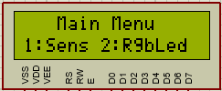
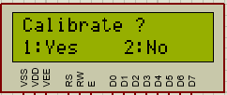


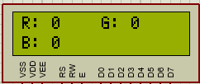

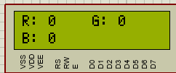

1: Sensor
2: RGB LED
1: Yes
2: No
1: Color Input
2: Real Time
(Show sensed color)
* = OK

Slide 11
Output RGB LED
Using 1 PWM and 2 digital output pins.
Pin | Task
1 PWM | Setting the corresponding intensity of each color
2 Digital Output Pins | Switching to the right color at the right moment
ATMega 328p
PWM
Demux
R
RGB
LED
G
Digital outputs
B
GND
00 → Red
01 → Green
10 → Blue

Slide 12
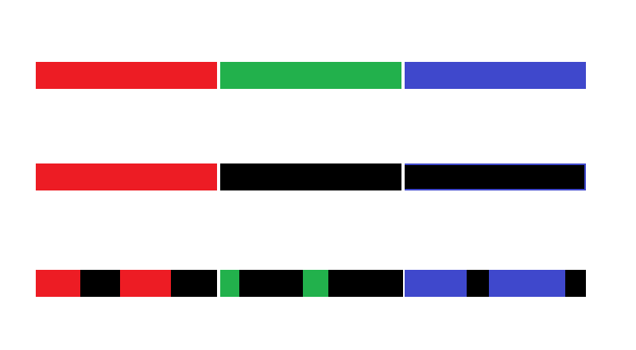
One Time Frame
For green
For blue
RGB value
Switching freq. 10Hz
T = 0.1s
30Hz
For red
255,255,255
255, 0, 0
At least 10- time frames per second
is required to avoid blinking
128, 50, 200
PWM time period (50% duty cycle)
Switching freq. 30Hz
T =33.33ms
00 → Red
01 → Green
10 → Blue
ATMega 328p
PWM
Demux
R
RGB
LED
G
Digital outputs
B
Default Max PWM freq. = 980Hz
Totally enough but we obtained the highest frequency as follows

Slide 13
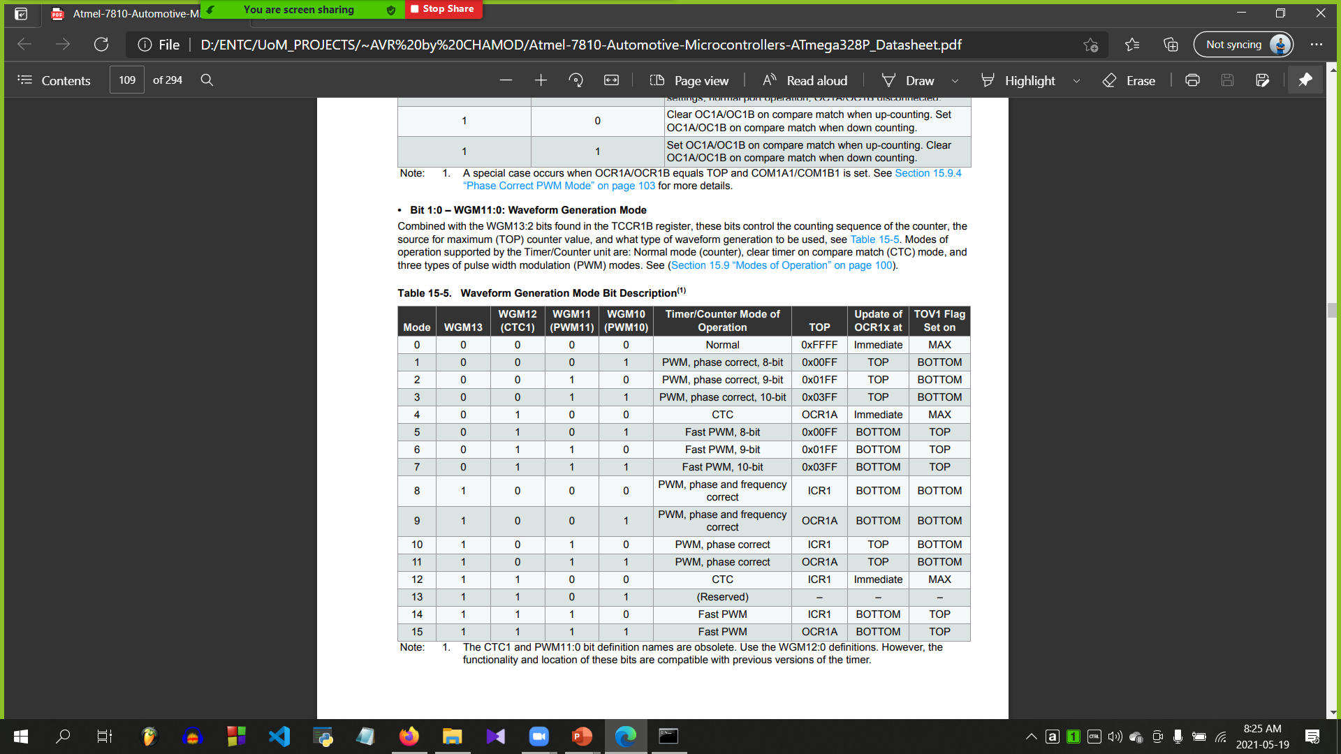
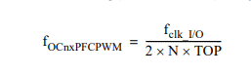
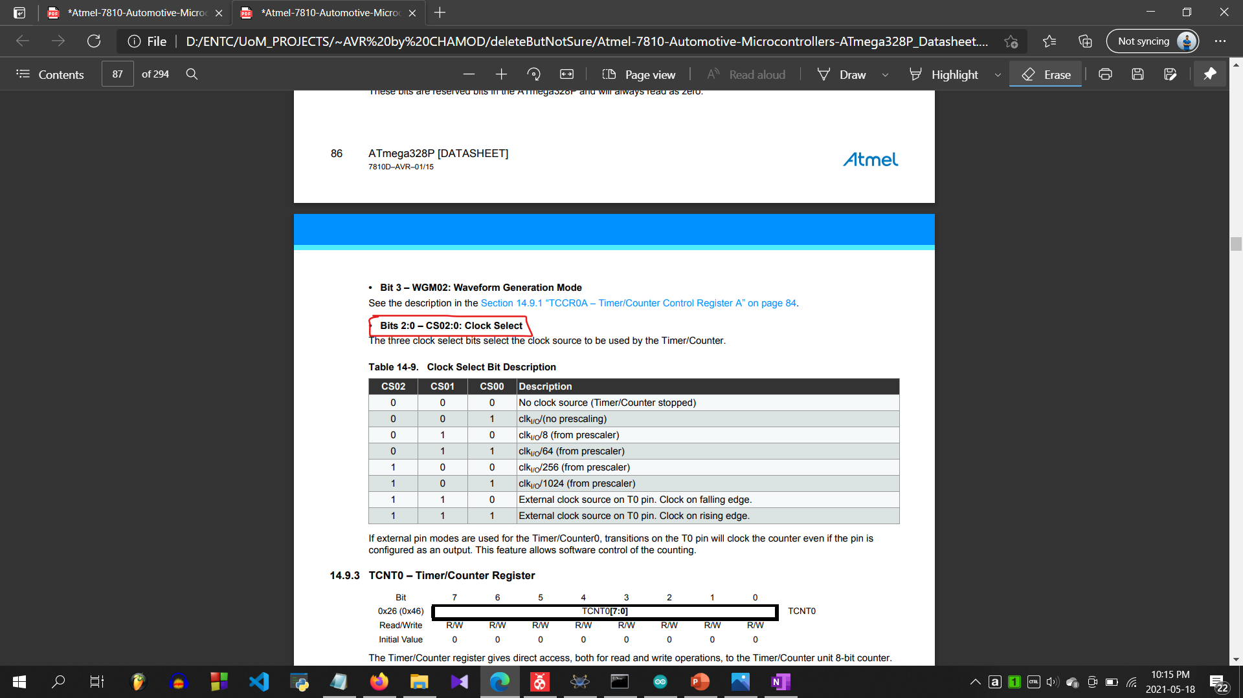
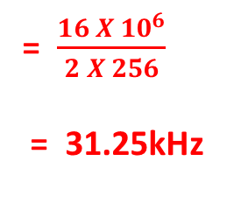
Getting the maximum switching speed
With the 16MHz oscillator maximum counter with 256 states have the frequency 31.125kHz
8-bit
= $\frac{16 X{ 10}^{6}}{2 X 256}$
= 31.25kHz

Slide 14
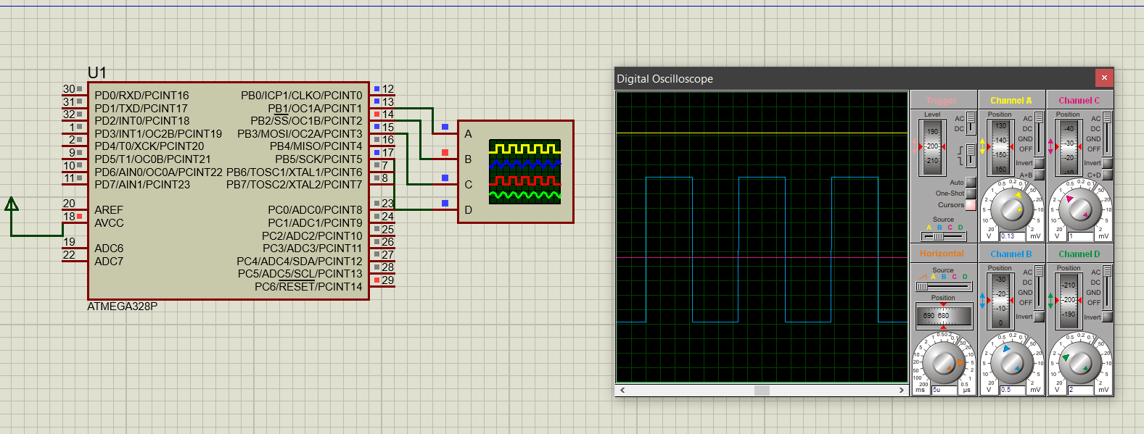
And it is working correctly in Proteus
~32us
5us
For 128 (50% duty cycle)

Slide 15
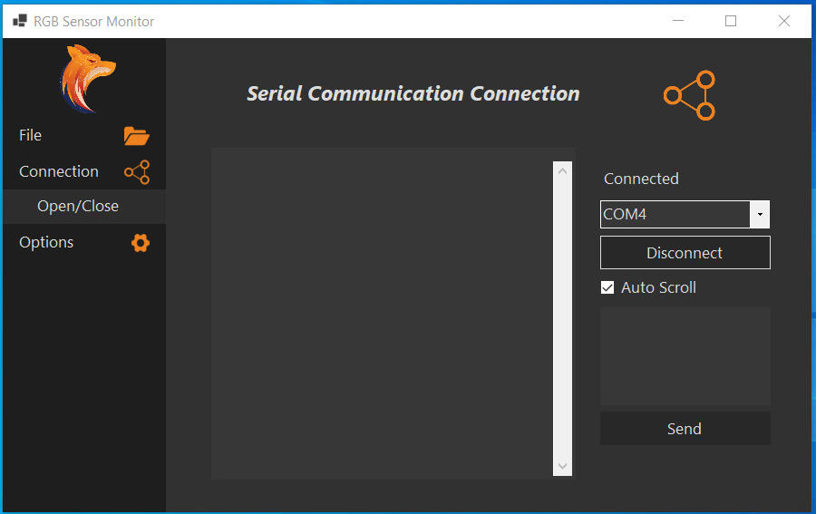
Bluetooth and User Interface for PC
We created a user interface for windows using C#.
Connecting to sensor via Bluetooth.
(Can be disconnected from both pc and sensor itself.)
Calibration
Reading real time color and recording in a log file
Sending a specified color and lighting the LED
Sending any message to display

Slide 16
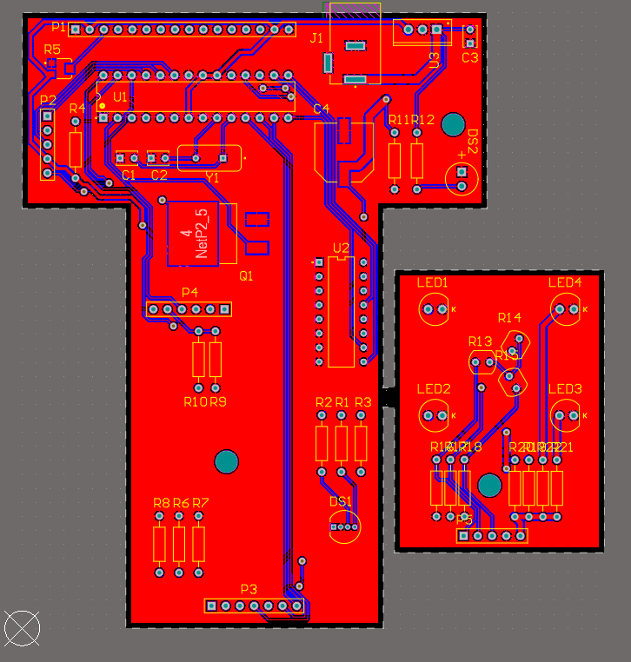
PCB Design
Display - connection
Power
Sensor - connection
Bluetooth
Sensor
Motherboard
Keypad - connection

Slide 17
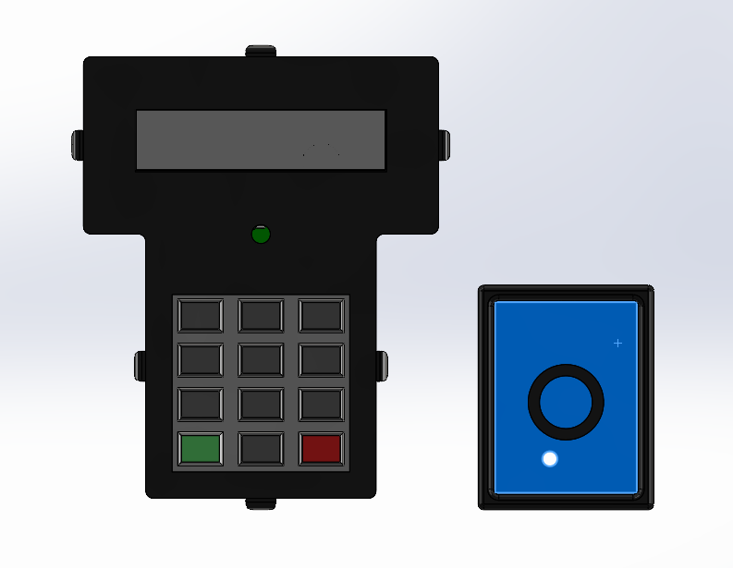
Enclosure

